Slide 1

Daria Solodey
Methodologist, course creator, English teacher

Slide 2
🔥
Our goal
Pass a job interview
Our rules:
Turn on your camera
Set up your microphone
Be active
Notes:
Если вам не хватило места, вы можете здесь написать развернутый комментарий.

Slide 3
Choose any number from 1 to 3.
1 2 3

Slide 4
This number is a number of facts that you have to say about yourself.
1 2 3

Slide 5

Lesson Plan:
Study how to answer the question:
“Tell me about yourself”
Discuss the reasons why people fail job interviews
Notes:
Развернутый комментарий.

Slide 6


Look at Jack. Why is he so excited?
Is it challenging to pass a job interview? Why (not)?

Slide 7
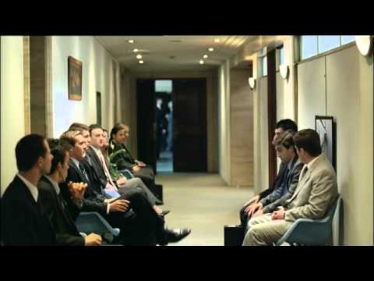
Why do you think some people fail their job interviews?
Have you ever failed your job interviews? Why?
Watch the video.
Is it a good way to get a job?
Would it work in real life?

Slide 8
Share your ideas on how to succeed at a job interview
Dos Don’ts
Greet the interviewer Take phone calls
__________________ __________________
__________________ __________________
__________________ __________________
__________________ __________________
__________________ __________________
__________________ __________________
__________________ __________________
__________________ __________________
__________________ __________________

Slide 9
Read the tips on how to succeed at the interview.
Guess top reasons for failing it.
8 reasons why people fail job interviews
❓
Tip: set an alarm for 6 a.m and plan your route
❓
Tip: research the company’s social media to find out what outfit is appropriate in the company
❓
Tip: prepare answers to basic questions in advance, avoid parasite words
❓
Tip: speak positively and confidently about your knowledge and skills
5. ❓
Tip: prepare some positive examples of communication with the previous employer
6. ❓
Tip: give a firm handshake, smile, and maintain eye contact
7. ❓
Tip: prepare a list of questions in advance
8. ❓
Tip: research some info about the company on their website, read the customer reviews.
Notes:
https://wordwall.net/resource/57182389

Slide 10
8 reasons why people fail job interviews
Being late for the interview
Tip: set an alarm for 6 a.m and plan your route
❓
Tip: research the company’s social media to find out what outfit is appropriate in the company
❓
Tip: prepare answers to basic questions in advance, avoid parasite words
❓
Tip: speak positively and confidently about your knowledge and skills
7. ❓
Tip: prepare some positive examples of communication with the previous employer
8. ❓
Tip: give a firm handshake, smile, and maintain eye contact
9. ❓
Tip: prepare a list of questions in advance
10. ❓
Tip: research some info about the company on their website, read the customer reviews.

Slide 11
8 reasons why people fail job interviews
Being late for the interview
Tip: set an alarm for 6 a.m and plan your route
Inappropriate appearance
Tip: research the company’s social media to find out what outfit is appropriate in the company
❓
Tip: prepare answers to basic questions in advance, avoid parasite words
❓
Tip: speak positively and confidently about your knowledge and skills
5. ❓
Tip: prepare some positive examples of communication with the previous employer
6. ❓
Tip: give a firm handshake, smile, and maintain eye contact
7. ❓
Tip: prepare a list of questions in advance
8. ❓
Tip: research some info about the company on their website, read the customer reviews.

Slide 12
8 reasons why people fail job interviews
Being late for the interview
Tip: set an alarm for 6 a.m and plan your route
Inappropriate appearance
Tip: research the company’s social media to find out what outfit is appropriate in the company
Inability to communicate clearly
Tip: prepare answers to basic questions in advance, avoid parasite words
❓
Tip: speak positively and confidently about your knowledge and skills
5. ❓
Tip: prepare some positive examples of communication with the previous employer
6. ❓
Tip: give a firm handshake, smile, and maintain eye contact
7. ❓
Tip: prepare a list of questions in advance
8. ❓
Tip: research some info about the company on their website, read the customer reviews.

Slide 13
8 reasons why people fail job interviews
Being late for the interview
Tip: set an alarm for 6 a.m and plan your route
Inappropriate appearance
Tip: research the company’s social media to find out what outfit is appropriate in the company
Inability to communicate clearly
Tip: prepare answers to basic questions in advance, avoid parasite words
Showing no enthusiasm and confidence
Tip: speak positively and confidently about your knowledge and skills
5. ❓
Tip: prepare some positive examples of communication with the previous employer
6. ❓
Tip: give a firm handshake, smile, and maintain eye contact
7. ❓
Tip: prepare a list of questions in advance
8. ❓
Tip: research some info about the company on their website, read the customer reviews.

Slide 14
8 reasons why people fail job interviews
Being late for the interview
Tip: set an alarm for 6 a.m and plan your route
Inappropriate appearance
Tip: research the company’s social media to find out what outfit is appropriate in the company
Inability to communicate clearly
Tip: prepare answers to basic questions in advance, avoid parasite words
Showing no enthusiasm and confidence
Tip: speak positively and confidently about your knowledge and skills
5. Saying bad things about previous employers
Tip: prepare some positive examples of communication with the previous employer
6. ❓
Tip: give a firm handshake, smile, and maintain eye contact
7. ❓
Tip: prepare a list of questions in advance
8. ❓
Tip: research some info about the company on their website, read the customer reviews.

Slide 15
8 reasons why people fail job interviews
Being late for the interview
Tip: set an alarm for 6 a.m and plan your route
Inappropriate appearance
Tip: research the company’s social media to find out what outfit is appropriate in the company
Inability to communicate clearly
Tip: prepare answers to basic questions in advance, avoid parasite words
Showing no enthusiasm and confidence
Tip: speak positively and confidently about your knowledge and skills
5. Saying bad things about previous employers
Tip: prepare some positive examples of communication with the previous employer
6. Poor eye contact and body language
Tip: give a firm handshake, smile, and maintain eye contact
7. ❓
Tip: prepare a list of questions in advance
8. ❓
Tip: research some info about the company on their website, read the customer reviews.

Slide 16
8 reasons why people fail job interviews
Tip: set an alarm for 6 a.m and plan your route
Tip: research the company’s social media to find out what outfit is appropriate in the company
Tip: prepare answers to basic questions in advance, avoid parasite words
Showing no enthusiasm and confidence
Tip: speak positively and confidently about your knowledge and skills
Being late for the interview
Tip: set an alarm for 6 a.m and plan your route
Inappropriate appearance
Tip: research the company’s social media to find out what outfit is appropriate in the company
Inability to communicate clearly
Tip: prepare answers to basic questions in advance, avoid parasite words
Showing no enthusiasm and confidence
Tip: speak positively and confidently about your knowledge and skills
5. Saying bad things about previous employers
Tip: prepare some positive examples of communication with the previous employer
6. Poor eye contact and body language
Tip: give a firm handshake, smile, and maintain eye contact
7. Not asking questions
Tip: prepare a list of questions in advance
8. ❓
Tip: research some info about the company on their website, read the customer reviews.

Slide 17
8 reasons why people fail job interviews
Being late for the interview
Tip: set an alarm for 6 a.m and plan your route
Inappropriate appearance
Tip: research the company’s social media to find out what outfit is appropriate in the company
Inability to communicate clearly
Tip: prepare answers to basic questions in advance, avoid parasite words
Showing no enthusiasm and confidence
Tip: speak positively and confidently about your knowledge and skills
5. Saying bad things about previous employers
Tip: prepare some positive examples of communication with the previous employer
6. Poor eye contact and body language
Tip: give a firm handshake, smile, and maintain eye contact
7. Not asking questions
Tip: prepare a list of questions in advance
8. Lack of knowledge about the company or the position
Tip: research some info about the company on their website, read the customer reviews.

Slide 18


Slide 19
Before we watch the video, let’s practise the new words
Bachelor’s degree
Master’s Degree
To take the path of
Bold career shift
To be endorsed by
To be cut out for
Brave changing the type of job or profession you’ve been doing
Given one's public approval or support
A degree that is given to a student by a college or university usually after one or two years of additional study
To be naturally able or suited to do or be (something)
To start your career in a new sphere
A degree that is given to a student by a college or university usually after four years of study

Slide 20
Before we watch the video, let’s practise the new words
Bachelor’s degree
Master’s Degree
To take the path of
Bold career shift
Endorsed by
To be cut out for
Brave changing the type of job or profession you’ve been doing
Given one's public approval or support
A degree that is given to a student by a college or university usually after one or two years of additional study
To be naturally able or suited to do or be (something)
To start your career in a new sphere
A degree that is given to a student by a college or university usually after four years of study

Slide 21
Answer the questions. Use the phrases below.
Have you got a bachelor’s degree? If yes, which subject do you have a degree in? If no, would you like to have it?
Have you got a master’s degree? If yes, which subject do you have a degree in? If no, would you like to have it?
Have you ever made a bold career shift? Would you like to make it now?
Have you taken any courses endorsed by high-profile institutions?
Why have you decided that you are cut out for
working in IT?
Use the phrases:
I really feel that…
To my mind…
I guess/believe that…
Let me think…
To be honest...

Slide 22
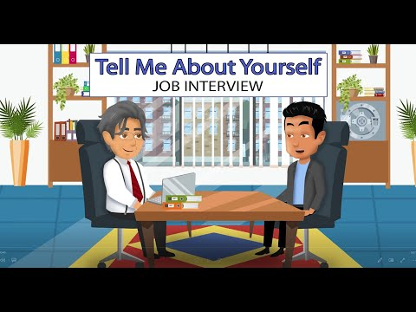
Watch the video till (1:36-3:31) and answer the questions
What degrees did Mr Torres complete?
Is his education relevant to the position he is applying for?
What was his first job? Is it relevant experience? Did he like it?
Was the answer to the first question short or long?
What additional question did the employer ask? What did
Mr Torres answer? What details did he provide?

Slide 23
Mark the sentences as TRUE or FALSE. Explain yourself.
F
Mr Torres tells the employer about his age and marital status.
He speaks about relevant education.
His answer to the question “Tell me about yourself” is long and detailed.
Mr Torres provides additional information about his background only when the employer asks him about it.
T
F
T

Slide 24
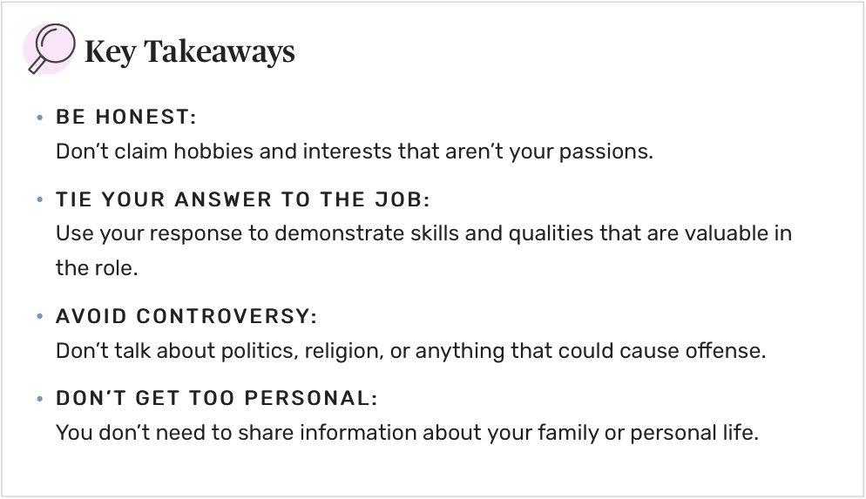
Read the tips one by one. Explain why each point is important.

Slide 25
Tell me about yourself
I am… (Daniel Smith).
I am… (a full-stack developer).
I know… (CSS, JavaScript)
I did ___ successful/individual projects.
I want to work for your company…
as it allows me to… (use my skills and knowledge I gained)
to have a great enthusiasm for… (working among like-minded people; creating IT products; developing new technologies; …)
to use my experience fully
* don’t use “junior”, as it may negatively influence your salary
* use only relevant info

Slide 26
EXAMPLE
"My name is Daniel Smith. I am a full stack developer. Coming to my skills I know CSS, HTML, JS. Also, I have mastered React and Node.js. I have been coding for 10 months and during this time I have done 3 successful team projects and 2 individual ones. Due to this I am good at core technical skills, organizational ethics and discipline. My goal is to get a job in a reputed company like yours where I can use my skills and knowledge to deliver good results in the long term. I am eager to achieve a good position in the company to scale up the organization’s production and growth rate and at the same time for my personal career growth as well. That’s all about me. And yes, thanks for the opportunity given to introduce myself!"

Slide 27
Homework
Answer the interview question Tell me about yourself
(see pr. slides) and send to your teacher for proofreading
Learn the glossary for the next lesson
Revise the glossary and presentation for this lesson
Find out more about:
Why People Fail Interviews: Top 13 Mistakes – Career Sidekick

Slide 28

What have you learnt this lesson?
I can:
answer the question: “Tell me about yourself”
understand the reasons why people fail job interviews
Notes:
Развернутый комментарий

Slide 29
Useful links:
Video:
Tell Me About Yourself - Job Interview

Slide 30
Thank you!

